Slide 1
Chapter 9: Virtual Memory

Slide 2
Chapter 9: Virtual Memory
Real versus Virtual Memory Systems
Demand Paging
Copy-on-Write
Page Replacement
Allocation of Frames
Thrashing
Memory-Mapped Files
Allocating Kernel Memory
Other Considerations

Slide 3
Objectives
To describe the benefits of a virtual memory system
To explain the concepts of demand paging, page-replacement algorithms, and allocation of page frames
To discuss the principle of the working-set model

Slide 4
Different Memory Organization
Real
Virtual
Single user system
Multiprogramming systems
Multiprogramming systems
Fixed Partition
Variable Partition
Absolute
Relocatable
paging
Segmentation
Combined
Processes must be entirely in in main memory and occupy uninterruptible memory location
Processes only need to be partially in main memory and occupy different sections of memory

Slide 5
Basic concepts about virtual memory
Virtual memory – separation of user logical memory from physical memory
Only part of the program needs to be in memory for execution
Logical address space can therefore be much larger than physical address space
Allows address spaces to be shared by several processes
Allows for more efficient process creation
More programs running concurrently
Virtual memory can be implemented via:
Demand paging
Demand segmentation

Slide 6
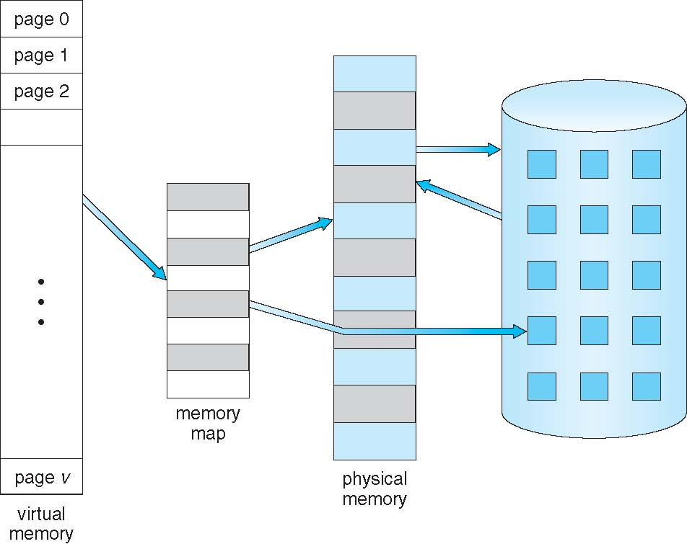
Virtual Memory That is Larger Than Physical Memory

Slide 7
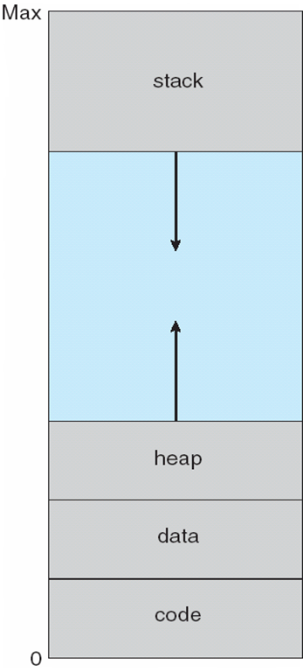
Virtual-address Space
Enables sparse address spaces with holes left for growth, dynamically linked libraries, etc.

Slide 8
Virtual Address Space
System libraries shared via mapping into virtual address space
Shared memory by mapping pages read-write into virtual address space
Pages can be shared during fork(), speeding process creation

Slide 9
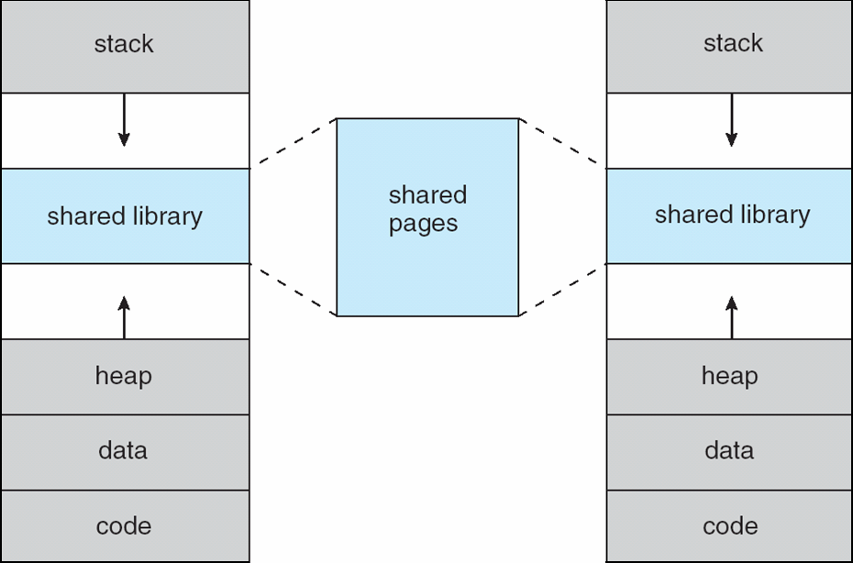
Shared Library Using Virtual Memory

Slide 10
Advantages of Virtual Memory
Greater number of processes can execute concurrently because only part of the processes needs to be in main memory
External fragmentation is eliminated in paging systems because every frame can be assigned to a process. In segmentation systems is still possible to have free memory where an entire segment cannot fit.
Program can be larger in size than available main memory

Slide 11
Demand Paging
Bring a page from disk into memory only when the page is referenced by a running process. A page fault brings the operating system into action
Less I/O needed, no unnecessary I/O
Less memory needed
Faster response
More users
Page is needed ⇒ reference to it
invalid reference ⇒ abort
not-in-memory ⇒ bring to memory
Lazy swapper – never swaps a page into memory unless page will be needed
Swapper that deals with pages is a pager

Slide 12
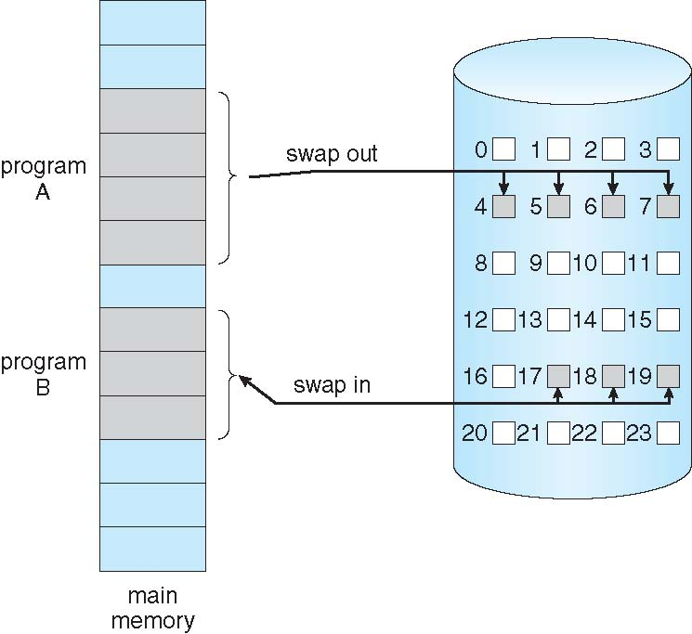
Transfer of a Paged Memory to Contiguous Disk Space

Slide 13
Valid-Invalid Bit
With each page table entry a valid–invalid bit is associated (v ⇒ in-memory – memory resident, i ⇒ not-in-memory)
Initially valid–invalid bit is set to i on all entries
Example of a page table snapshot:
During address translation, if valid–invalid bit in page table entry
is i ⇒ page fault
Frame #
valid-invalid bit
v
v
v
v
i
….
i
i
page table

Slide 14
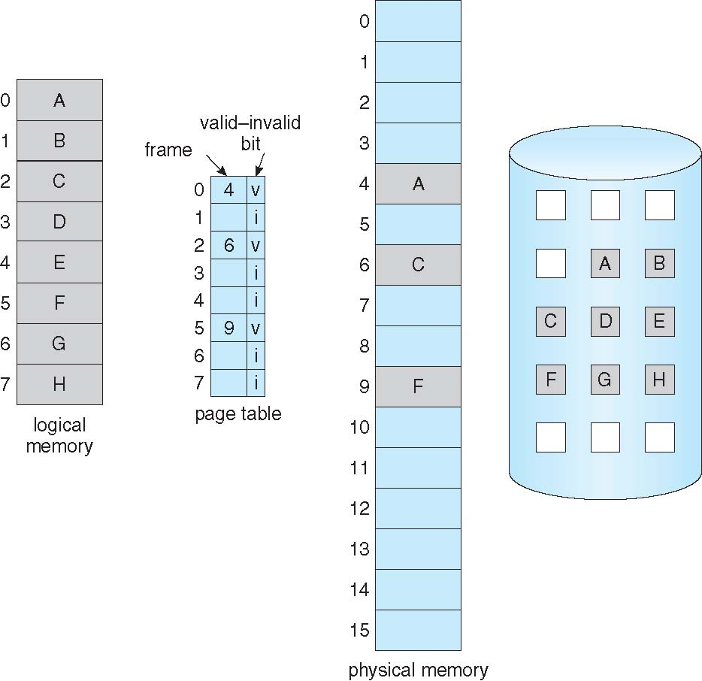
Page Table When Some Pages Are Not in Main Memory

Slide 15
Page Fault
If there is a reference to a page, first reference to that page will trap to operating system:
page fault
Operating system looks at another table to decide:
Invalid reference ⇒ abort
Just not in memory
Get empty frame
Swap page into frame via scheduled disk operation
Reset tables to indicate page now in memory Set validation bit = v
Restart the instruction that caused the page fault

Slide 16
Aspects of Demand Paging
Extreme case – start process with no pages in memory
OS sets instruction pointer to first instruction of process, non-memory-resident -> page fault
And for every other process pages on first access
Pure demand paging
Actually, a given instruction could access multiple pages -> multiple page faults
Pain decreased because of locality of reference
Hardware support needed for demand paging
Page table with valid / invalid bit
Secondary memory (swap device with swap space)
Instruction restart

Slide 17
Advantages and Disadvantages of Demand Paging
Advantages
The only processes brought into main memory are those that are required by the running processes
No overhead associated with predicting which page will be used next
Disadvantage
In terms of resources being tied up, it is more “expensive” to wait for a page transfer when a greater amount of main memory is occupied since other processes are being kept from using that memory space
auto increment/decrement location
Restart the whole operation?
What if source and destination overlap?

Slide 18
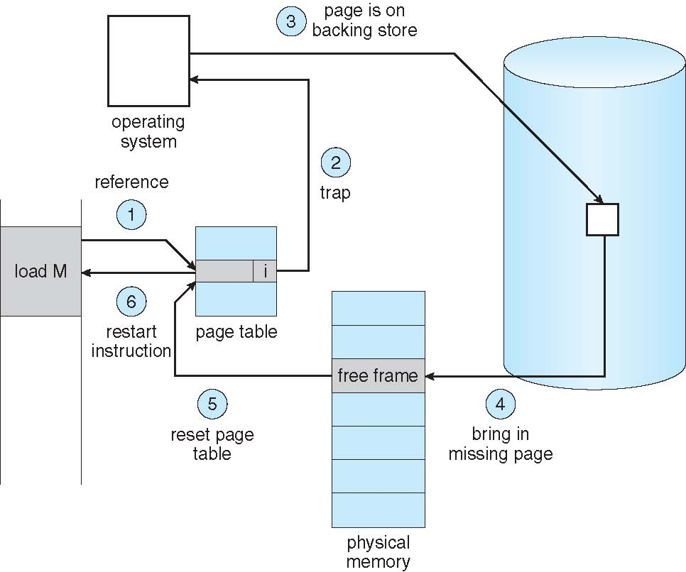
Steps in Handling a Page Fault

Slide 19
Performance of Demand Paging
Stages in Demand Paging
Trap to the operating system
Save the user registers and process state
Determine that the interrupt was a page fault
Check that the page reference was legal and determine the location of the page on the disk
Issue a read from the disk to a free frame:
Wait in a queue for this device until the read request is serviced
Wait for the device seek and/or latency time
Begin the transfer of the page to a free frame
While waiting, allocate the CPU to some other user
Receive an interrupt from the disk I/O subsystem (I/O completed)
Save the registers and process state for the other user
Determine that the interrupt was from the disk
Correct the page table and other tables to show page is now in memory
Wait for the CPU to be allocated to this process again
Restore the user registers, process state, and new page table, and then resume the interrupted instruction

Slide 20
Performance of Demand Paging (Cont.)
In any case , we are faced with three major components of the page-fault service time:
Service the page-fault interrupt
Read in the page
Restart the process
Page Fault Rate 0 ≤ p ≤ 1
if p = 0 no page faults
if p = 1, every reference is a fault
Effective Access Time (EAT):
EAT = (1 – p) x memory access + p (page fault overhead + swap page out + swap page in + restart overhead )

Slide 21
Demand Paging Example
Memory access time = 200 nanoseconds
Average page-fault service time = 8 milliseconds
EAT = (1 – p) x 200 + p (8 milliseconds)
= (1 – p x 200 + p x 8,000,000
= 200 + p x 7,999,800
If one access out of 1,000 causes a page fault, then
EAT = 8.2 microseconds.
This is a slowdown by a factor of 40!!
If want performance degradation < 10 percent
220 > 200 + 7,999,800 x p 20 > 7,999,800 x p
p < .0000025
< one page fault in every 400,000 memory accesses

Slide 22
Demand Paging Optimizations
Copy entire process image to swap space at process load time
Then page in and out of swap space
Used in older BSD Unix
Demand page in from program binary on disk
Used in Solaris and current BSD

Slide 23
Copy-on-Write
Copy-on-Write (COW) allows both parent and child processes to initially share the same pages in memory
If either process modifies a shared page, only then is the page copied
COW allows more efficient process creation as only modified pages are copied
In general, free pages are allocated from a pool of zero-fill-on-demand pages
vfork() variation on fork() system call has parent suspend and child using copy-on-write address space of parent
Designed to have child call exec()
Very efficient

Slide 24
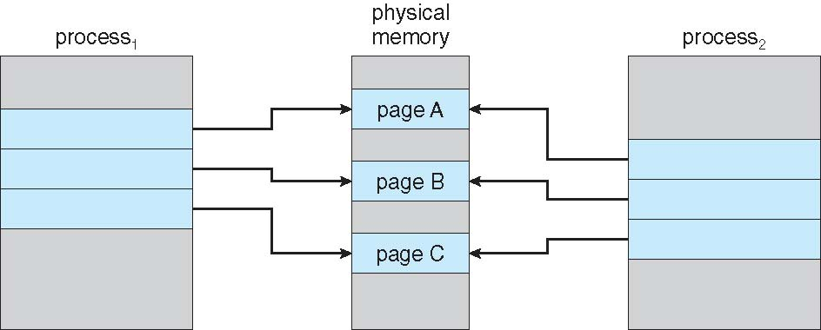
Before Process 1 Modifies Page C

Slide 25
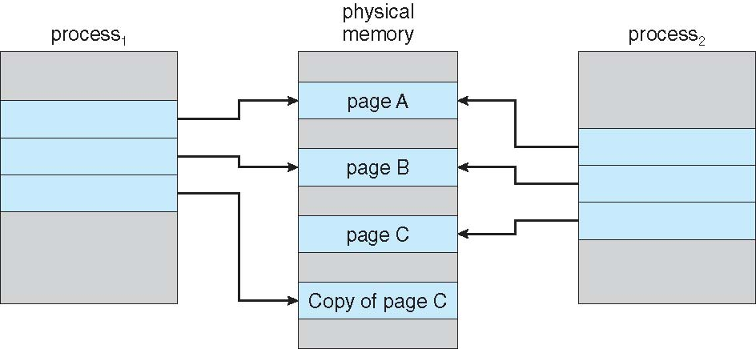
After Process 1 Modifies Page C

Slide 26
What Happens if There is no Free Frame?
Used up by process pages
Also in demand from the kernel, I/O buffers, etc.
How much to allocate to each?
Page replacement – find some page in memory, but not really in use, page it out
Algorithm – terminate? swap out? replace the page?
Performance – want an algorithm which will result in minimum number of page faults
Same page may be brought into memory several times

Slide 27
Page Replacement
Prevent over-allocation of memory by modifying page-fault service routine to include page replacement
Use modify (dirty) bit to reduce overhead of page transfers – only modified pages are written to disk
Page replacement completes separation between logical memory and physical memory – large virtual memory can be provided on a smaller physical memory

Slide 28
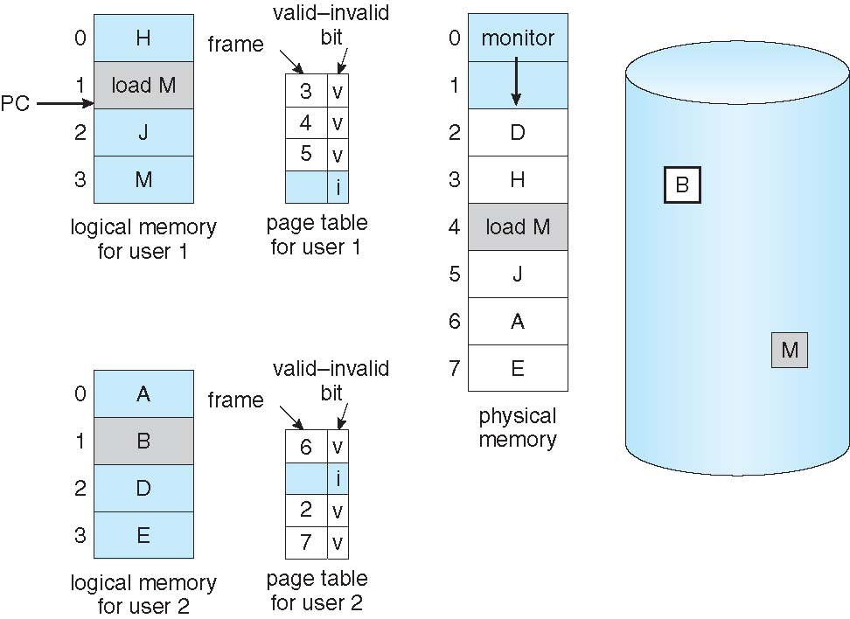
Need For Page Replacement

Slide 29
Basic Page Replacement
Find the location of the desired page on disk
Find a free frame: - If there is a free frame, use it - If there is no free frame, use a page replacement algorithm to select a victim frame - Write victim frame to disk if dirty
Bring the desired page into the (newly) free frame; update the page and frame tables
Continue the process by restarting the instruction that caused the trap
Note now potentially 2 page transfers for page fault – increasing EAT

Slide 30
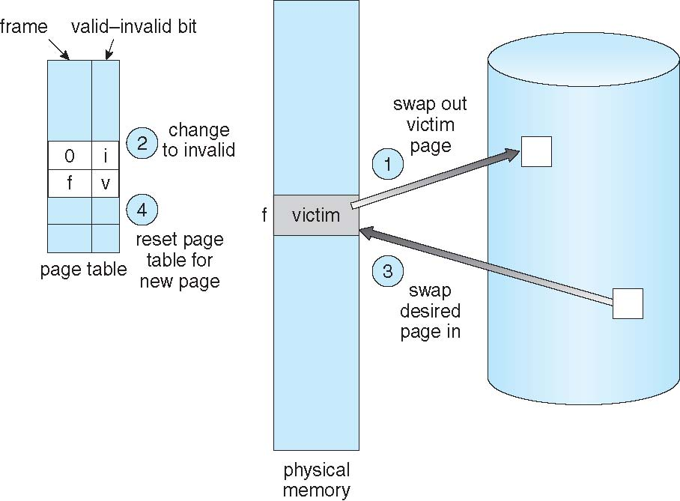
Page Replacement

Slide 31
EAT -example
A paging system is experiencing a page fault rate of 1 in 1 million page references. 20% of the time that a page fault occurs, an empty frame is not available and frame replacement is needed. When frame replacement is needed, 60% of time the frame has been modified and it takes 25 milliseconds to service the page fault, in contrast it takes 15 milliseconds when the frame to be replaced has not been modified. Whenever frame replacement is not needed it takes 10 milliseconds to service the page fault. It takes 150 nanoseconds to reference a physical memory location and we can neglect the time that it takes to access the page table.
Calculate the effective memory access time for this system under these conditions. Clearly indicate intermediate steps.

